Slide 1
Decision trees for choosing inferential statistical tests
Adapted from: Gunawardena, N. (2011) Choosing the correct statistical test in research. Sri Lanka Journal of Child Health, 40(4), 149-153.

Slide 2
Questions you ask
What is the data type? Nominal, ordinal (non-parametric), scale (parametric / normally distributed)
What is the hypothesis? Hypothesis of difference / hypothesis of association
Is the data dependent (within subjects) or independent (between subjects)?
How many measures are there? Number of conditions/groups

Slide 3
Notes
We do not cover all possible inferential statistical tests in the labs, as we do not have time.
I only include tests that we do cover in these decision trees.
In the labs, you will be taught by hypothesis and number of measures.
You should fill out this decision tree in your own time.

Slide 4
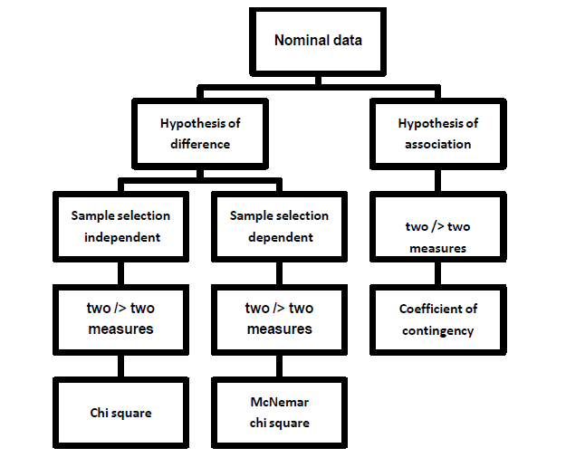
Nominal data

Slide 5
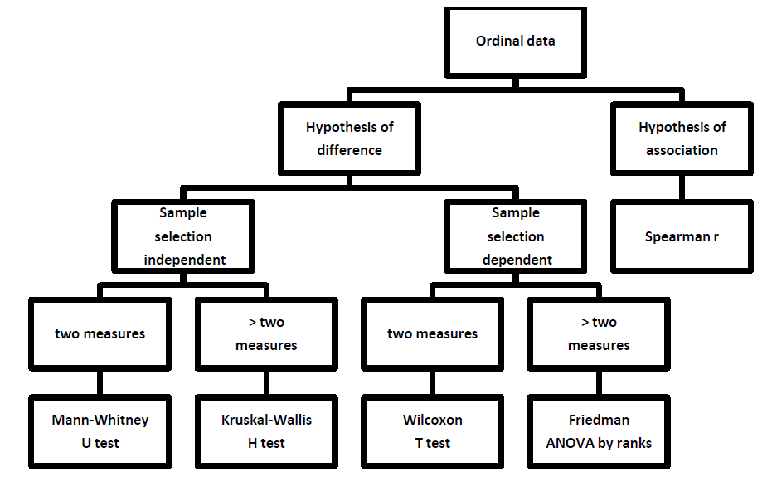
Ordinal/non—parametric data

Slide 6
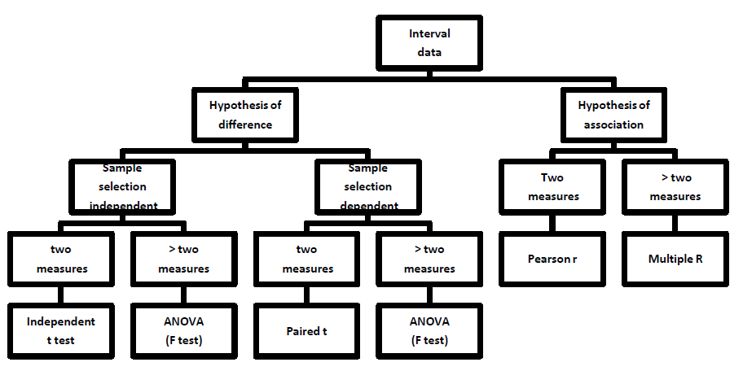
Scale / parametric data

